Slide 1

NIGERIAN ARTISTE YOUTUBE DATA REPORT
2006 - 2023
PRESENTED BY ENTERTAINMENT TEAM 1
MARCH 23, 2023

Slide 2

EXECUTIVE SUMMARY
The focus of this report is to highlight the performance of Nigerian Artiste on YouTube Platform. The dataset contains data from November 2006 – February 2023.
The data for this report was already collected by the organizers of this Hackathon.
The data was later cleaned, transformed, modelled and used for Analysis and Visualization.
01
This report was analyzed using Power BI. Several transformations was done like converting datatypes, cleaning whitespaces, splitting columns etc. Calculations was also carried out to arrive at the key metrics in this report.
Some of the calculations include Total Views, Subscribers, No of Artistes etc.
02
The important metrics used in this report include Monthly Trend of Views, Top 10 Artiste by Subscribers, Views, Most Viewed Songs, Relationship between Subscribers and Views, Artistes Information
03

Slide 3


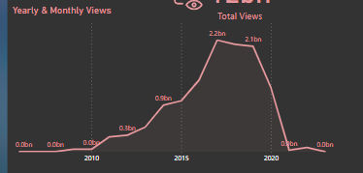
KEY FINDINGS
A total number of 100 Nigerian Artiste were used for analysis. 53million subscribers and 12billion views was recorded for the time frame of Analysis
The views has been increasing at a rather slow pace from 2006 and then there was an increase in 2017 which has the overall views of 2.17billion compared to 2020 when the world was on lockdown.
After 2019 with another 2.1billion views, there has been a sharp decline in the number of views.

Slide 4
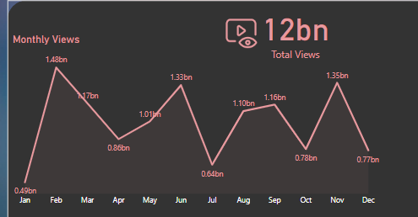
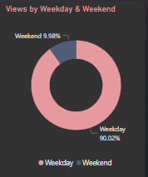
KEY FINDINGS
The month of February has recorded the highest number of views with a total of 1.48billion and a difference of over 900million from January which recorded the lowest views of 491million views
The songs recorded more views of 90.02% during weekdays compared to weekends which has 9.98%

Slide 5
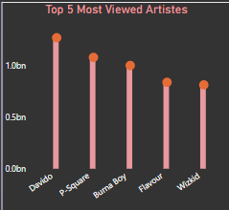
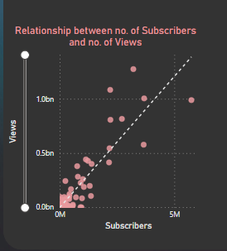
KEY FINDINGS
Davido is the artiste with the highest views of 1.2billion followed by Psquare with over 1billion. Burna boy, Flavour and Wizkid are third, fourth and fifth respectively.
Davido had a total of more than 537million views in 2017 which is 26% out of the total views for 2017.
There is a linear and positive relationship between subscribers and views .

Slide 6
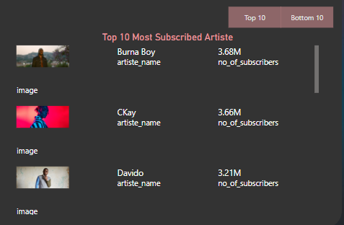
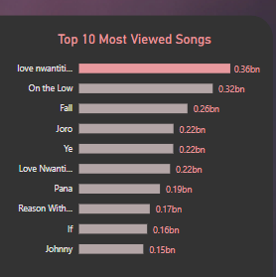
KEY FINDINGS
Burna boy has the highest number of subscribers of 3.68million while Hot kid has the lowest with 736 subscribers on the streaming platform
The most viewed Nigerian Song is Love nwantiti by Ckay with a total of 358million views. The acoustic version of the same song is number 6 on the top 10 chart with shows a high performance of the Nigerian Song amongst others.

Slide 7

RECOMMENDATION
Since the lockdown and after, lifestyles and habits have changed. Artiste should try and keep up with trends and as well as adopt digital strategy to keep engaging their viewers.
Most times, YouTube consumes a lot of data so most users prefer to watch songs with short videos, clear videography . Other users jump on trending social media platforms to listen to most songs so Artiste should create digital footprints and showcase their music on these apps.

Slide 8
Thank you for Listening

